Slide 1

Hanzi Database
Organization of Chinese
Characters
by Helena Kazenski
CS333 - Database Systems
December 2025

Slide 2
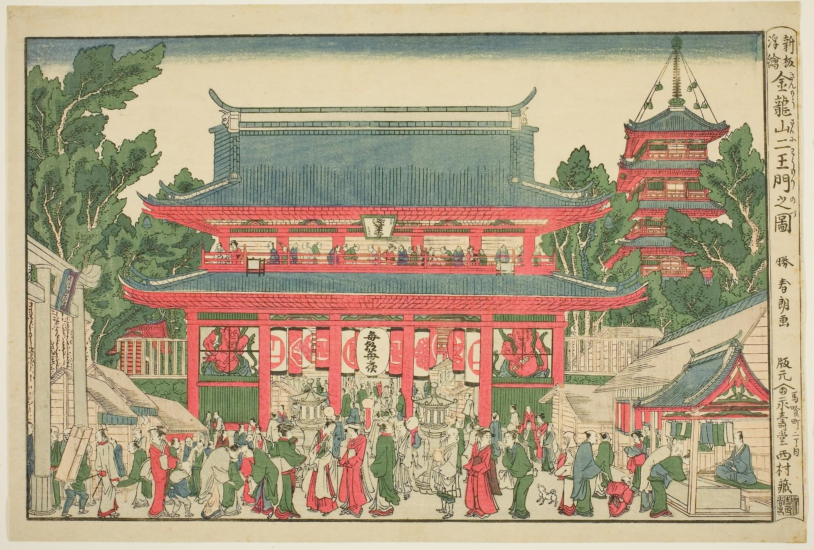
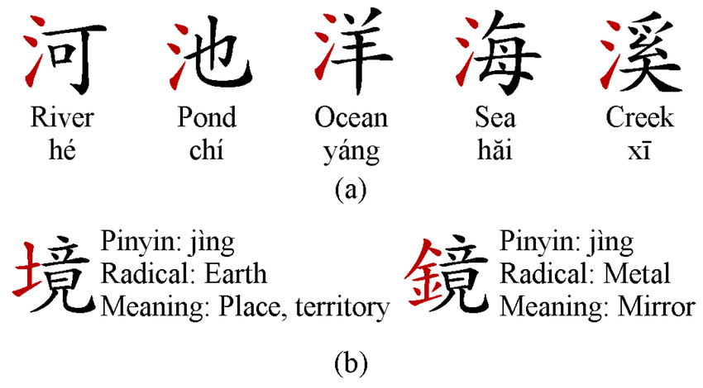
What are hanzi?
*Example of radical usage in hanzi
Oldest continuously used writing system in the world.
Logographic; each character represents a word, or concept, rather than just a sound like letters.
Components; hanzi characters are composed of radicals (components that convey meaning) and phonetic elements.

Slide 3
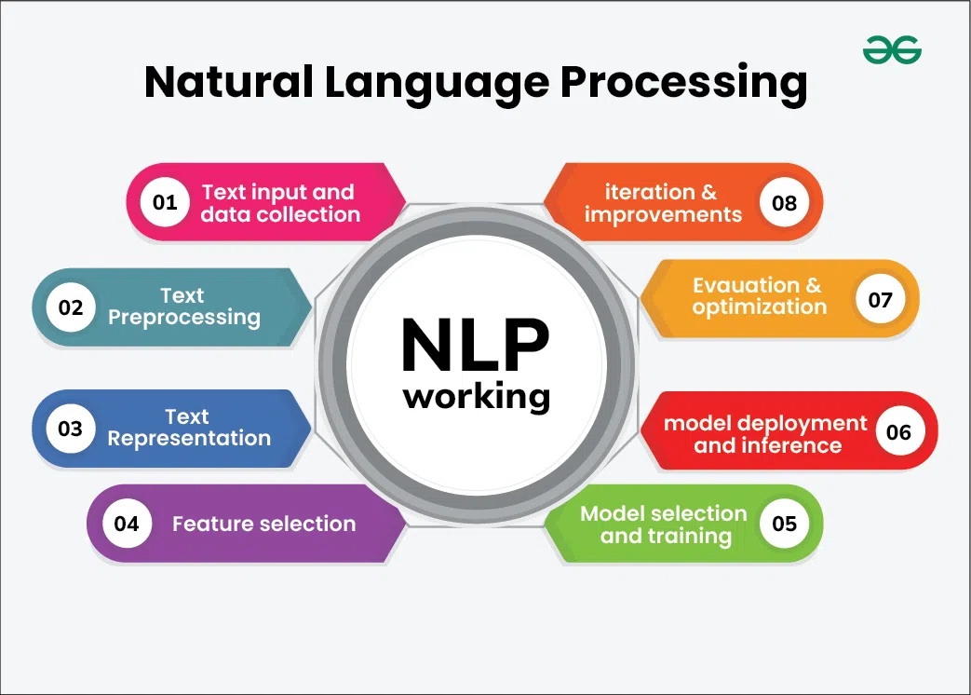
Why a hanzi database?
*NLP process; many steps of which could utilize this database
While similar to a dictionary, this database has the potential to be expanded further to carry out more functions, such as:
  Can help with language learning.
      Ex. semantic field could be used to search for groups of words that a user would like to learn.
  Data could be used to create an app for learning, using usage frequency level and popular fields for prioritizing lesson content.
  Can be expanded to support NLP projects.
      Ex. speech recognition, machine translation, etc.
  Can be scaled to meet specific needs perhaps not met with standard dictionaries.

Slide 4
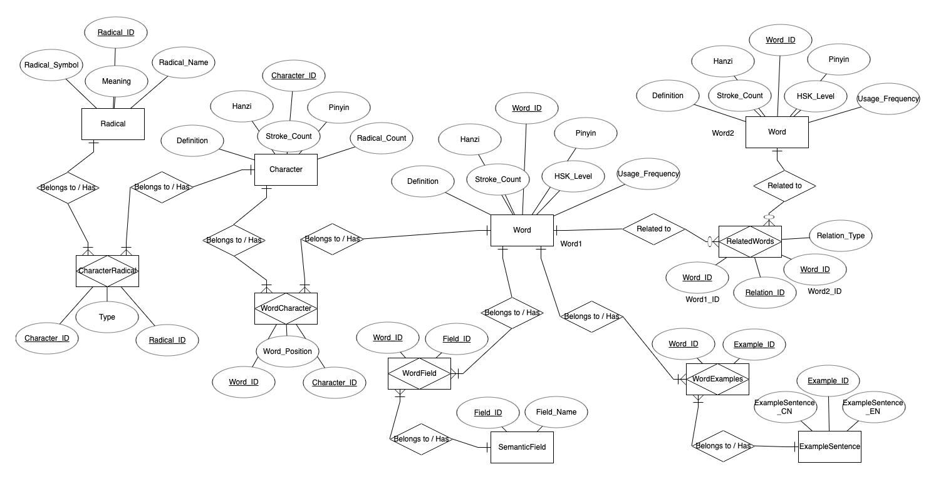

Slide 5
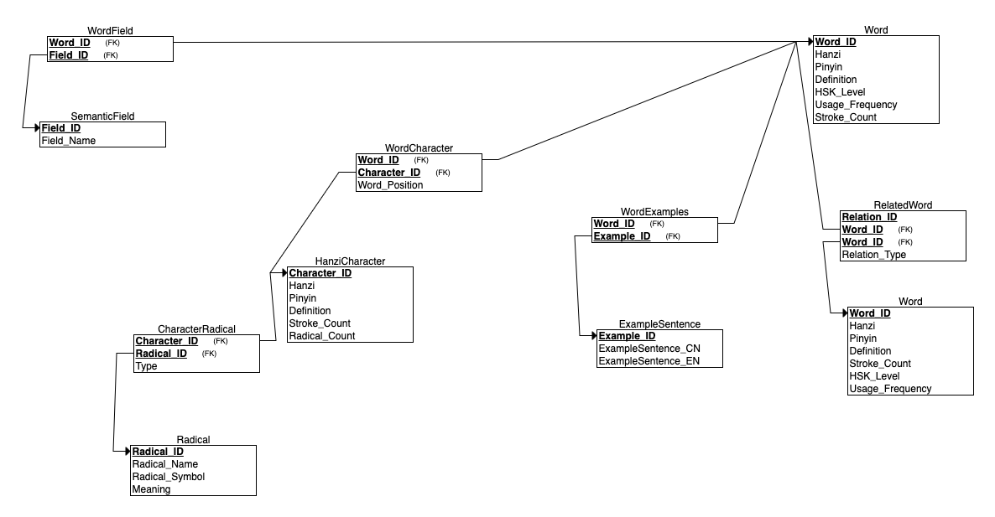

Slide 6
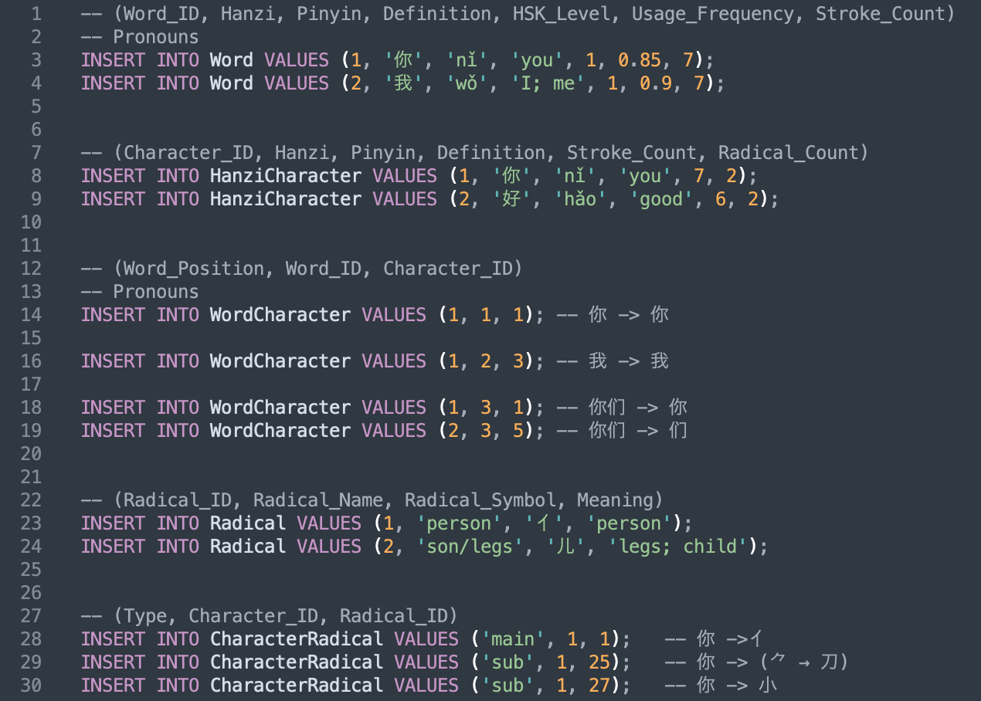
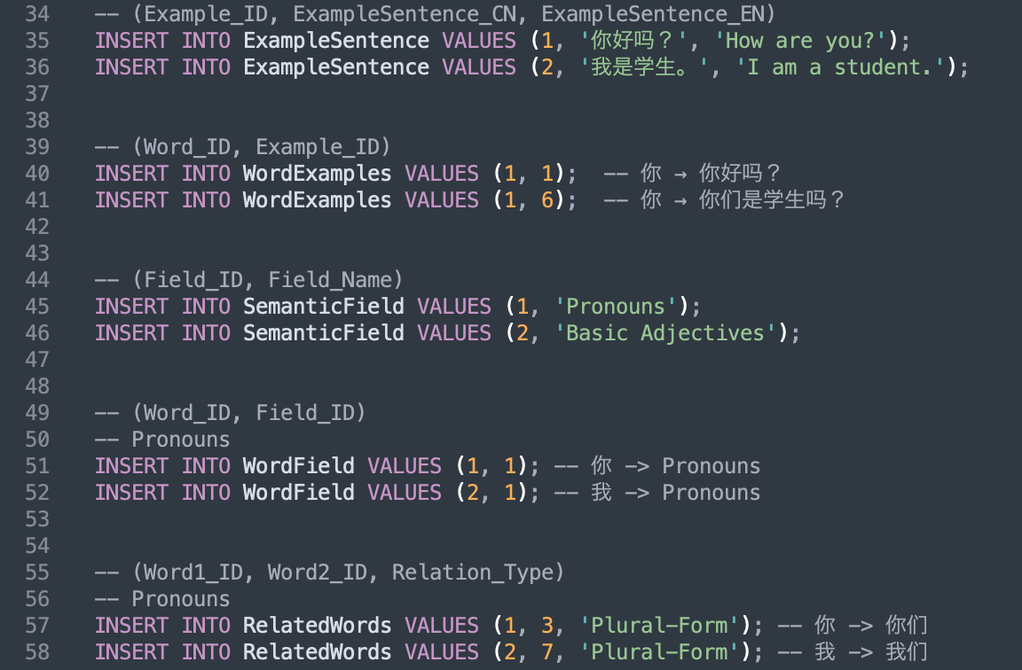
Data Insert Samples:

Slide 7
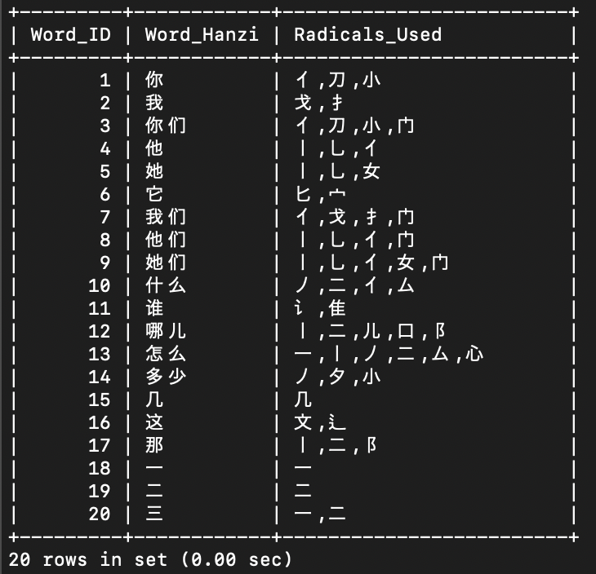
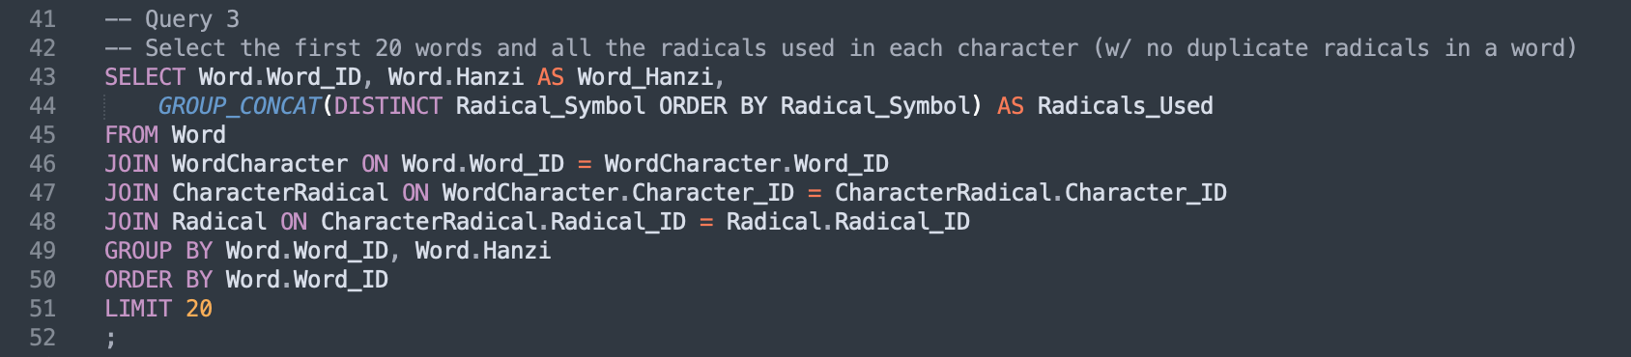
Query Example 1:
Takes the first 20 words and lists each radical used, removing duplicates
Group_Concat the radicals to format them into the list in the Radicals_Used column
Needs Word, WordCharacter, CharacterRadical, and Radical to be joined together

Slide 8
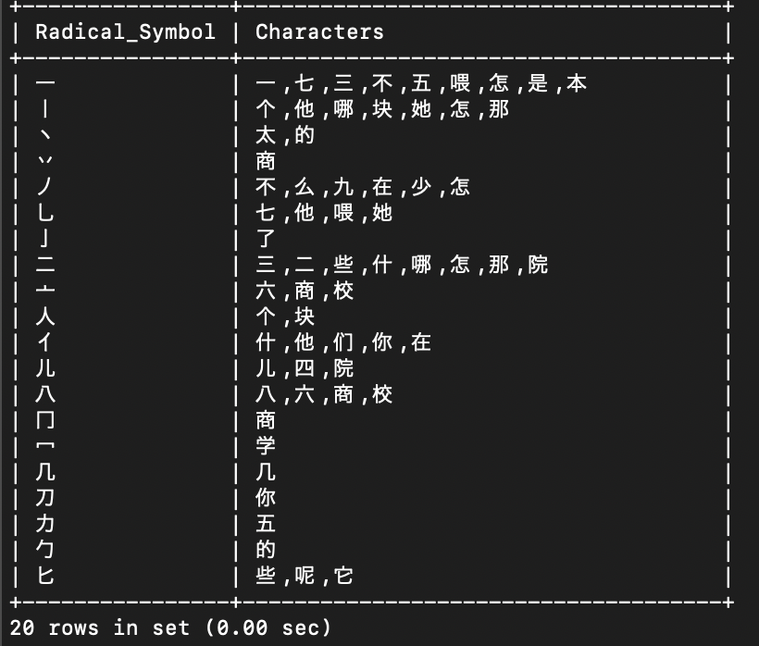
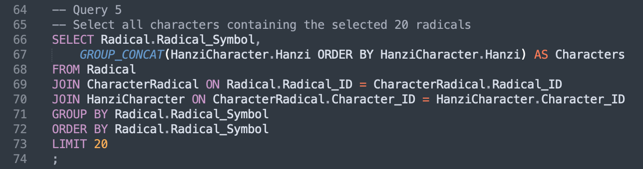
Query Example 2:
Takes 20 radicals and lists all the characters that contain them in the database
Group_Concat used again for list format
Joins Radical, CharacterRadical, and HanziCharacter together

Slide 9
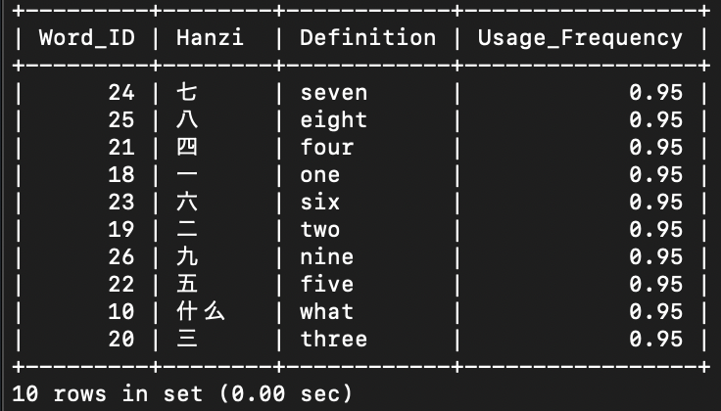
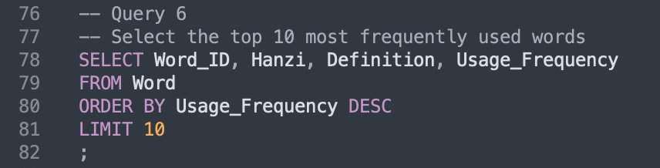
Query Example 3:
Lists the top 10 most frequently used words in the database
Simple, but useful; can be used for teaching prioritization

Slide 10
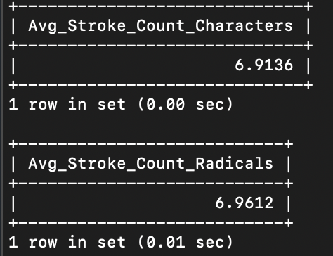
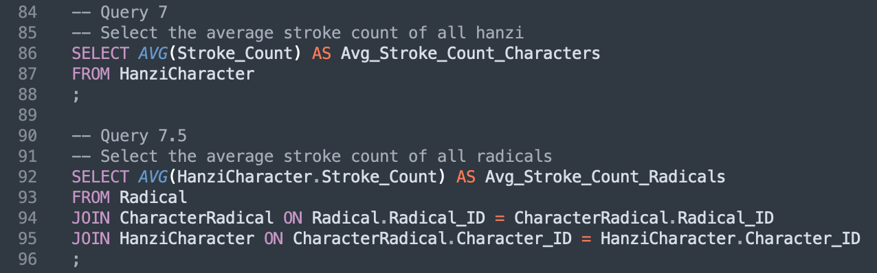
Query Example 4:
Calculates the average stroke count of all hanzi and all radicals in the database
Again, simple, but can be useful for data analysis
For 7.5, Radical, CharacterRadical, and HanziCharacter all need to be joined, as radical alone doesn’t log stroke counts

Slide 11
Lessons learned:
By applying my interests in NLP + Computational Linguistics, I’ve become more confident that I do in fact want to pursue this field, as I had a lot of fun working on this project
I’ve practiced and greatly improved my SQL skills throughout this project
I’ve learned a lot from the challenges I’ve had throughout this process, and am more comfortable fixing mistakes and coming up with workarounds when something doesn’t work as intended

Slide 12
谢谢你！
Thank you!

